Slide 1

2018 Residential Rate methodology

Slide 2

OVERVIEW
Timeline of the new Residential Rate Methodology roll-out
Benefits of the new Residential Rate Methodology
Residential Rate Methodology overview
How rates are determined
Future Outcome Payment options
Rate and Category Review Processes
Transition Planning

Slide 3
What is the timeline?
The new Residential Rate Methodology will be used to establish care and supervision rates starting on January 1, 2018 for new residential placements and enrollments.
A transition plan will be developed for care and supervision rates for currently existing placements to be moved into the new Residential Rate Methodology on January 1, 2018.

Slide 4
What are the benefits?
In identifying a new methodology, several considerations were made. These include:
Using a model that can be used for 90% of rates (non-outliers)
Aligning the member acuity score with the Department of Health Services’ regression model used to set MCO capitation rates
Creating acuity bands to reduce the impact of minor changes in acuity
Providing transparency as to how the rates are developed
Developing outcome goals for 2018 that will drive rate enhancements for 2019

Slide 5
What are the benefits (cont’d)
Additional considerations, based on provider feedback, were also built into the new model.
Providing more stability and predictability from year to year
Compensating for specialized or high level cares
Considering quality components, community involvement and member outcomes

Slide 6
What are the key elements
Residential Rate Methodology is comprised of 3 component areas:
Acuity of Member – Based upon the LTC Functional Screen
Level of Service – Includes services not captured within the Acuity of the member
Outcomes – Reimbursement opportunity for providers that meet established outcomes

Slide 7
What are the key elements
Acuity Component
The Regression Model – a holistic picture of the member, based on target group, multiple areas of the LTC Functional Screen, and determined cost drivers for the target group as developed by the State
Acuity Band Values –The acuity numbers are added together for an overall acuity score. An acuity score falls into an acuity band
Regression Percentage – Based on averages and rate trends

Slide 8
What are the key elements
Level of Service Component
Provider Categories – Based upon target group, average acuity of the members served, staffing model, overnight care, and behavioral/medical specialties
Ability to build in services offered that are above and beyond what is required and not included within the acuity portion of the rate
Example: Category change for providers that serve Advanced Dementia and Alzheimer’s disease
Ongoing evaluation of provider services to determine whether additional enhancements should be made

Slide 9
What are the key elements
Outcome Component
New opportunity for providers to gain reimbursement based on offering an additional level of care through identified outcomes
The criteria used to develop the outcomes to be utilized in 2019 include:
Both provider and member specific outcomes
Outcomes that will be simplistic to measure and operationalize

Slide 10
Tool overview
Key components of the tool:
Total Member Acuity based on DHS Target group-specific Regression Model
Acuity Band Value
Category of Residential Provider
Regression Percentage (based on averages and rate trends)

Slide 11
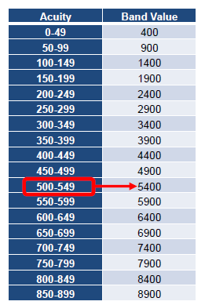
Tool overview (cont’d)
Acuity Band Value:
The acuity numbers are added together for an overall acuity score. That acuity score falls into an acuity band.
Each acuity band is assigned a value to which a percentage is applied
The band value used is on the high end of the acuity range

Slide 12
Tool overview (cont’d)
Category of the Residential Provider:
The model utilizes category assignments for each provider
Categories are determined based upon target group, average acuity of the members served, staffing model, overnight care, and behavioral/medical specialties
Includes category definition for providers that serve Advanced Dementia and Alzheimer’s Disease
There are 5 Provider Categories in the current methodology
Your contract addendum will identify which category your facility(ies) are in

Slide 13
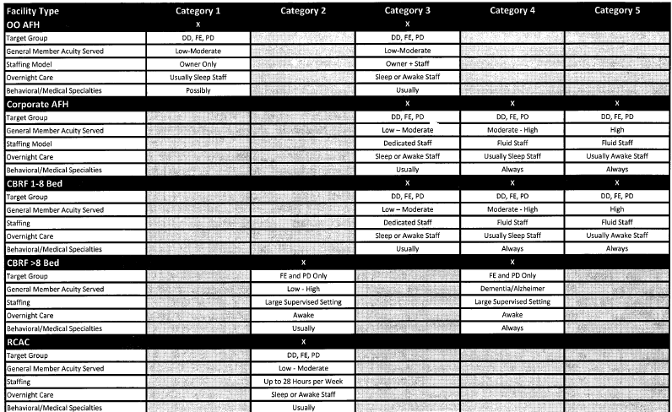
Tool overview (cont’d)

Slide 14
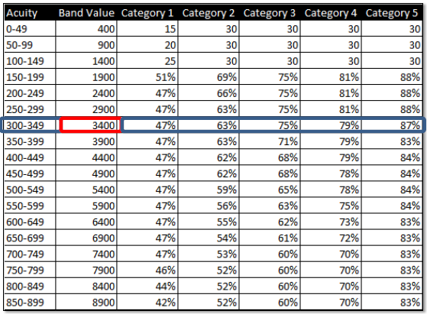
Tool overview (cont’d)
A member with an acuity score of 310 would fall into the 300-349 acuity band.
A band value of $3,400 is assigned
Dependent upon the category of residential provider, the designated percentage is the amount of the regression value that is used to pay residential care and supervision
Most members have other serviced provided beyond residential care and supervision

Slide 15
Tool overview (cont’d)
Let’s Calculate!
Member’s Acuity Band Value
X
Percentage =
Monthly Care and Supervision Rate
Divided by 30.4 (average days per month) =
Daily Care and Supervision Rate

Slide 16
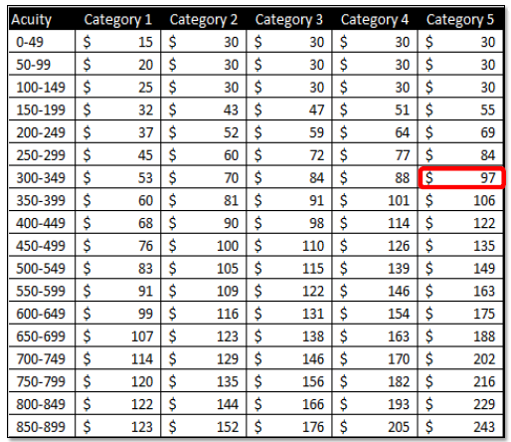
Tool overview (cont’d)
A member with an acuity score of 310 would fall into the 300-349 acuity band.
A band value of $3,400 is assigned
If the member was in a Category 5 facility, the designated percentage of the amount of the regression value is 87%
$3,400 x 87% = $2,958 (monthly)
$2,958 / 30.4 = $97.30
Rounded = $97 Daily Rate

Slide 17
What are outcome-based payments?
In 2018, Inclusa will define the outcomes for providers that, if met, would result in an enhanced rate in 2019.
Outcomes create opportunities for providers to gain reimbursement based on providing an additional level of care not captured within the acuity portion of the rate tool.
The criteria used to develop the outcomes to be utilized in 2019 include:
Both provider and member specific outcomes
Outcomes that will be simplistic to measure and operationalize

Slide 18
What are outcome-based payments?
The outcomes will focus on:
Provider’s Internal Quality Initiatives
Influenza Vaccination
Behavioral Support Planning
Employment/Community Involvement

Slide 19
Residential review types
Significant Change in Condition (CIC) Review – Providers seeking a rate change due to a member’s significant change in condition are reviewed on a weekly basis.
Outlier Review – Occurs when a member’s support needs are unique and complex and fall outside of the residential rate methodology. This review will require providers to submit budgets and staffing information for each member.
Provider Category Review – Opportunity for providers to request a review if their services appear to be at a higher level than the category to which they were initially assigned.

Slide 20
questions
Jan Ash Jan.Ash@Inclusa.org 715-598-2448
Linnea Fiser Linnea.Fiser@Inclusa.org 608-785-3630
Becky Kuehl Rebecca.Kuehl@Inclusa.org 715-301-1652
Karla Lubinski Karla.Lubinski@Inclusa.org 608-785-9903

