Slide 1


Competitive Integrated Employment (CIE) Outcome: The Job Keeping Plan
A Training for Residential Providers
Notes:
Welcome! to Inclusa’s training module for Residential Providers on the Job Keeping Plan. This training is part of Inclusa’s Competitive Integrated Employment (CIE) Outcome Payment opportunity, which is aimed at increasing the number of individuals with disabilities who achieve and maintain competitive integrated employment.
The focus for today is on the Job Keeping Plan and how this tool guides important efforts that can help individuals keep their jobs. This is a training for Inclusa Residential Providers and describes how they can support Inclusa members in staying successfully employed.

Slide 2
Learning Objectives
Job Keeping Plan Training Module
Recognize the value of employment and how ongoing commitment & motivation is necessary to stay employed
Understand the role of Residential Providers in employment success
Get informed on Competitive Integrated Employment (CIE) and the related Outcome Payment opportunity
Learn how to complete the Job Keeping Plan
Notes:
Today’s Learning Objectives are:
Recognize the value of employment and how ongoing commitment & motivation is necessary to stay employed
Understand the role of Residential Providers in employment success
Get informed on Competitive Integrated Employment (CIE) and the related Residential Provider Outcome Payment opportunity
Learn how to complete the Job Keeping Plan
Thank you for participating in this training module. Now let’s get started …

Slide 3

Employment - Is Important for All of Us
Provides much needed income
Relationships
Contribution to our community
Grows our skills, knowledge and experiences
Keeps us healthy
  Prevents social isolation
  Increases self-esteem
  Promotes positive mental & physical health
Notes:
As we all know, employment is an important part of our lives.
Having a job, provides us with income that supports our life and well-being. It makes new relationships possible – with co-workers, supervisors and possibly customers. It gives us purpose and enables us to contribute to our community. Working offers us new experiences and challenges that grow our skills and knowledge.
And employment keeps us healthy and engaged – it gets us out of the house, keeps us connected and prevents social isolation; it boosts our morale and self identity and increases our self-esteem; it promotes positive mental and physical health which are the foundation of a good life.
For all of these reasons: Once individuals achieve employment, we want to do everything we can to support them to remain successful and keep their jobs.

Slide 4

Employment -
Requires Ongoing Commitment and Motivation
Achieving employment is the first career victory people experience
Maintaining employment, staying satisfied and motivated, often requires ongoing attention and support
This includes critical attention and support from residential providers, if a member receives residential services
Notes:
No matter what jobs we’ve had across our careers, we know employment requires ongoing commitment and motivation:
Achieving employment is the first career victory people experience
Maintaining employment, staying satisfied and motivated, often requires ongoing attention and support
This includes critical attention and support from residential providers, if a member receives residential services

Slide 5

The Role of Residential Providers
Residential Providers are central to members’ lives
You often have long-term, trusting relationships with members and know them well
Want to fully leverage those relationships & the daily contact members have with their residential providers
Invite more engagement re: job keeping & teaming with other supports
Many examples of providers helping people keep their jobs – tells us this support can be essential to long-term employment success
Want to encourage & recognize your effort through Outcome Payments
Notes:
Inclusa is excited to encourage Residential Providers to become more involved in the employment efforts surrounding the people they support. Your role in employment is very important.
As Residential Providers, you are often so central to members’ lives. In many cases, you have known a member for years and have built a strong, trusting relationship. Our goal is to leverage those relationships and the daily contact you have with members at home and invite you to engage more with the effort to keep people successfully employed. Inclusa has seen many residential providers in our network effectively support individuals in keeping their jobs so we know you can be an essential part of a person’s long-term employment success. We want to encourage more of this kind of engagement, and recognize the effort of residential providers by offering an outcome payment tied to this support.
We believe your involvement can be very valuable, can help support the team effort that keeps people in jobs, and can ultimately keep more Inclusa members working and thriving in our communities.

Slide 6

Competitive Integrated Employment (CIE)
Committed to ensuring working-age members from 18-64 yrs. who are already working in the community get the supports they need to stay employed
Notes:
Inclusa is committed to ensuring working-age members from 18-64 yrs. who are already working in the community get the supports they need to stay employed

Slide 7
Competitive Integrated Employment (CIE)
The CIE Outcome offers an opportunity for residential providers to receive an outcome payment for identifying and providing the assistance that a member needs to keep their CIE
Information on how to apply is sent to eligible providers in the spring of each year and available throughout the year on the Inclusa website
After an application is accepted by Inclusa, provider is eligible to receive the outcome payment for each member on the provider's list upon completion of the four requirements
Notes:
Inclusa is offering Residential Outcome Payments to contracted residential providers who are utilizing Inclusa’s Residential Rate Methodology (RRM). This program will offer opportunities for providers to receive an outcome payment for assisting members in keeping their job in the community
After an application is accepted by Inclusa, provider is eligible to receive the outcome payment for each member on the provider's list upon completion of the four requirements

Slide 8
Requirements for Outcome Payment
Competitive Integrated Employment (CIE)
Complete this Inclusa training module
Complete a Job Keeping Plan that is approved by the member and his/her team (use Inclusa template)
Assist the member to keep his/her CIE by following the Job Keeping Plan and documenting the related efforts (includes working collaboratively with any other providers or natural supports who may be involved)
Claim 100% of the Residential Outcome Payment if the member is still employed after 6 months of applying for this outcome and completing all requirements.
Notes:
The 4 requirements for a CIE Outcome Payment are:
Complete this Inclusa training module
Complete a Job Keeping Plan that is approved by the member and his/her team (use Inclusa template)
Assist the member to keep his/her CIE by following the Job Keeping Plan and documenting the related efforts
(includes working collaboratively with any other providers or natural supports who may be involved)
4. Claim 100% of the Residential Outcome Payment if the member is still employed in CIE after 6 months of applying for this outcome and completing all requirements.

Slide 9

Keeping Employment Successful – Together!
Develop and complete the Job Keeping Plan:
In partnership with members who are already working in the community (in CIE)
With input from the Care Team, natural supports, and the Job Coach, if one is already working with the member
Notes:
In a few moments we’re going to talk through the Job Keeping Plan template page by page so you understand what’s expected and how to complete the plan. As we talk through the Plan, please have a copy of the template to follow along and possibly take notes. It would be good for you also to have a copy of the supplemental tool we’ve created, Job Keeping Plan – Support & Activities Checklist.
The aim of Inclusa’s “Competitive Integrated Employment” initiative is to keep members successfully employed – TOGETHER. Developing and completing the Job Keeping Plan needs to be done:
In partnership with members who are already working in the community (in CIE)
With input from the person’s Care Team, their natural supports and/or family members, and the person’s Job Coach, if one is already working with the member

Slide 10

Keeping Employment Successful – Together!
Keep in Mind:
This is an innovative, new approach – let’s learn as we go
Communication will be key!
Keeping a positive “we can do this together” attitude
Individual is at the center & should lead/ be very engaged in the effort
Marina Zlochin/Adobe Stock
Notes:
It’s important to keep in mind that:
This is an innovative, new approach for Residential Providers to be this engaged in the job keeping process. Please ask questions of your Community Resource Coordinator (CRC) along the way, talk with and problem-solve with other supports involved (especially the person’s Job Coach if they have one) and know that we’ll be learning as we go – it will be worth it because of the potential outcomes for the people we support → long-term employment!
Communication will be key along the way – talk to each other
As with anything we do, keeping a positive “we can do this together” attitude will lead to better results – let’s tackle any obstacles or missteps along the way and keep moving forward
And, as always, the individual member is at the center. They should lead or be very engaged in the job keeping effort

Slide 11
The Job Keeping Plan
Member Information
Residential Provider Information
Source for Employment Supports
Network of Support
Employment Check-in
Quick Self-Assess for Residential Provider
Job Keeping Action Plan & Log
Plus – Support & Activities Checklist
Summary
Notes:
To give you a one-page snapshot of the Job Keeping Plan, here is a summary of what we’ll be talking through today:
Member Information
Residential Provider Information
Source for Employment Supports
Network of Support
Employment Check-in
Quick Self-Assess for Residential Provider
Job Keeping Action Plan & Log
Plus – Support & Activities Checklist

Slide 12
Completing Page #1 Basic Info
The Job Keeping Plan
Sections
Member Information
  ✓Check box to indicate member is already working in CIE and Community Resource Coordinator (CRC) has verified eligibility
Provider Information
  List agency and name/contact information for Staff Person who is developing plan with the member
Source for Employment Supports
  Fill out if member already has an Inclusa Supported Employment provider helping them on the job OR ✓ box if not used currently
Notes:
Now we’re ready to talk through the Job Keeping Plan template.
Starting on Page #1, we have three “basic info” sections:
Section 1. is to collect Member Information
Fill in the individual’s name, address and phone
Check the box to indicate you have verified with the Community Resource Coordinator (CRC) that the individual is working in CIE
Section 2. is to collect Provider Information
List your residential agency and the name, cell phone and email information for Staff Person who is developing the plan with the member
Section 3. is to indicate the Source for Employment Supports
Fill out if member already has an Inclusa Supported Employment provider helping them and providing Job Coaching OR check the box, if not currently utilized
Also indicate if other providers are involved, such as a Self Directed Supports or Supportive Home Care

Slide 13

Completing Page #2
The Job Keeping Plan
Section 4.
Network of Support
Who in the member’s life can help create the Job Keeping Plan?
Who does the member have solid relationships with and is in regular contact with who can support their employment success?
Key People to Engage
REMEMBER: If a Job Coach is involved, communicating & coordinating are essential
☑ If informed, engaged & supportive!
Individual Member Legal Guardian Inclusa CRC Job Coach | Prevoc Provider DVR Counselor Family Members Friends
Employment is a Team Effort!
Notes:
Now onto page #2:
This is Section 4 that involves the individual’s Network of Support. Think about … Who in the member’s life can help create the Job Keeping Plan? Who does the member have solid relationships with and is in regular contact with who can support their employment success?
List the name and contact information of the key people who are engaged.
On the right side of the chart, check to indicate others are informed/engaged & supportive of the Job Keeping Plan
Also, REMEMBER: If a Job Coach from another agency is involved, be sure to communicate and coordinate on this Job Keeping Plan. Employment is a Team Effort!

Slide 14
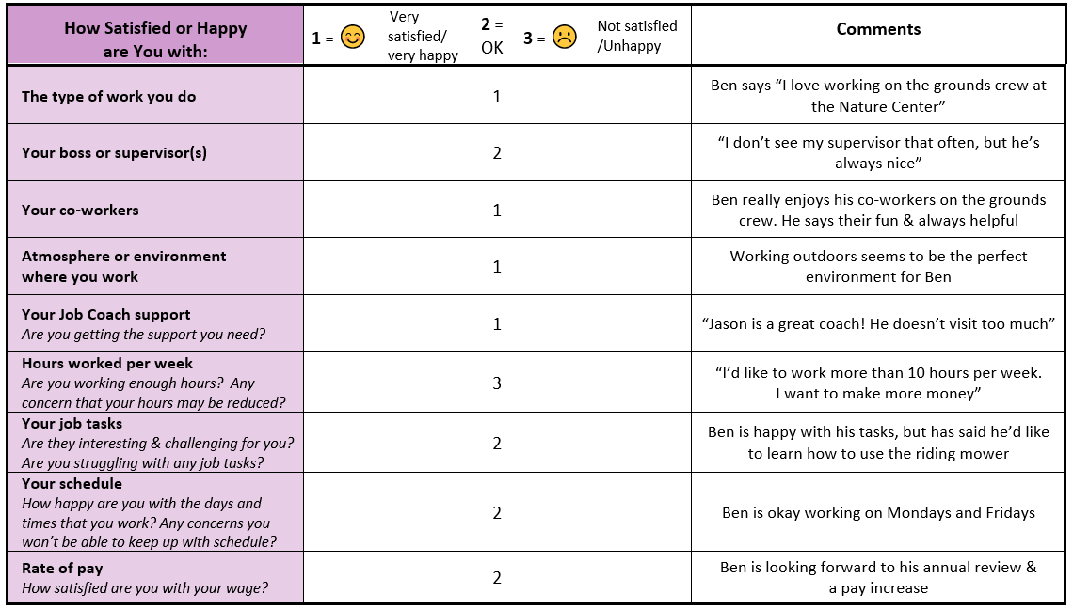




Employment Check-in
Section 5.
The Job Keeping Plan
Completing Page #3
Here’s an Example!
Notes:
Now let’s move onto page #3.
This is Section 5 which guides an Employment Check-in with the member.
Ask the member to tell you about the pros and cons of their job – what they like and don’t like. It’s an opportunity to give positive reinforcement around the things that are going well in the job. Also, if someone is feeling discouraged about an aspect of going to work, it’s best to get it out in the open. Sometimes just talking and sharing is enough to get something resolved. Other times, some problem solving with the member, their Job Coach or other supports might be needed.
In the example we’ve provided, you can see how the member has rated different aspects of their job. A “1 rating” indicates the member is very satisfied or very happy; a “2 rating” indicates the member is OK with that aspect of their job; and a “3 rating” indicates the member is not satisfied or is unhappy with that aspect of their job. Taking the time to add in comments is part of what’s expected on this part of the plan. It’s important to give a bit more information that explains or gives background on the member’s rating.

Slide 15
Completing Page #4
Quick Self-Assess for Residential Provider
The Job Keeping Plan
Section 6.
Think about the support your residential staff is currently providing the member to help them keep their job. In the following areas, how well is your residential staff doing in supporting the member to keep their employment?
Excellent Doing OK Needs attention
☑ | □ | □ | Meeting day-to-day expectations of the job
☑ | □ | □ | Supporting communication & Self determination
□ | □ | ☑ | Helping person stay healthy, balanced & positive
□ | ☑ | □ | Maintaining motivation to keep working
See the Job Keeping Support & Activities list for more details
Home staff could encourage Ben more to get off screens / video games and get more exercise. Will talk to Ben about setting some goals and get staff more involved.
Comments
Notes:
Now we’re on page #4:
In Section 6., you will complete the Quick Self-Assess for Residential Provider. Please think about the support your residential staff is currently providing the member to help them keep their job. In the following areas, how well is your residential staff doing in supporting the member in their employment?
Check the box in 4 main areas of support to assess how you and/or your staff are doing in regards to support:
Meeting day-to-day expectations of the job
Supporting communication
Helping person stay healthy, balanced & positive
Maintaining motivation to keep working
See the Job Keeping Support & Activities list for more details and also be sure to add a comment(s) to detail your assessment.

Slide 16
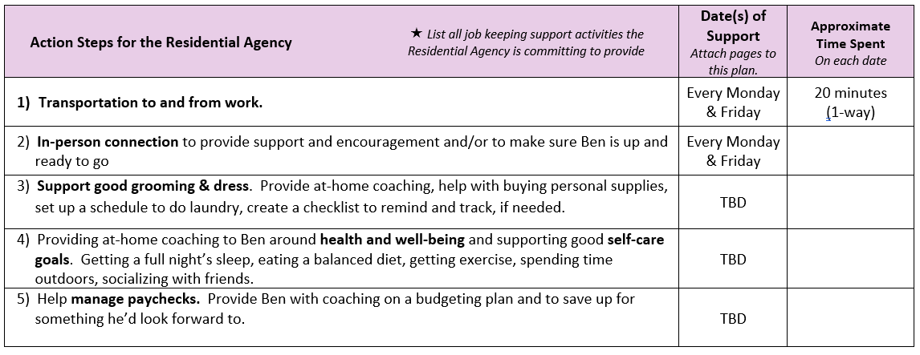

Completing Page #4-5 Job Keeping Action Plan & Log
The Job Keeping Plan
Section 7.
See the Job Keeping Support & Activities list for more details
Obtain and/or confirm information that may already be in Support Plan created by Job Coach. Do not duplicate what the Job Coach is doing. Instead do other things that are important and will help the member keep his/her employment: Do things the Job Coach does not have time to do, or is not in scope of Job Coaching service.
Notes:
Also on page #4 and on page #5, is:
Section 7. - the Job Keeping Action Plan & Log. This is where you’ll identify and track what your Residential Agency is doing to support the individual in successfully staying employed.
In this section, please also indicate (by checking one or the other box) if a Job Coach is involved –OR- is not involved.
If a Job Coach is involved, talk through what support is most needed, in addition to what the Job Coach is doing.
To give you ideas of the different ways you can help an individual get employed, we’ve created a supplemental Job Keeping Support & Activities Checklist. Use this list to get ideas about the kind of activities that your residential agency can do. Don’t duplicate what the Job Coach is doing: enhance the supports available to the member.
Communicate as the member continues in his/her job, address issues that arise and coordinate efforts. Keep the individual member involved and informed. In addition to doing things to help the member keep their job, do things to keep the member motivated and excited about continuing their employment.

Slide 17
Directions on Next Steps
Develop the Job Keeping Plan
#1 - You could first engage and consult with the member, the Job Coach (if involved), the member’s Care Team and natural supports/family
#2 – Then write up the Job Keeping Plan and share to confirm their support
OR
#1 – You could write up an initial draft version of the Job Keeping Plan with the member’s input
#2 – Then share with the Job Coach, Care Team and natural supports or family to get their review and feedback
Notes:
After completing this training module, we’re excited for you to get going on this process. Here are directions on your next steps:
You can approach developing the Job Keeping Plan in one of two ways:
#1 - You could first engage and consult with the member, the Job Coach (if involved), the member’s Care Team and natural supports/family
#2 – Then write up the Job Keeping Plan and share to confirm their support
OR
#1 – You could write up an initial draft version of the Job Keeping Plan with the member’s input
#2 – Then share with the Job Coach, Care Team and natural supports/family to get their review and feedback

Slide 18
Directions on Next Steps
Share
Share Job Keeping Plan with Inclusa Community Resource Coordinator (CRC) for review*
Update
Update Plan along the way as member maintains employment through the year*
Add
Add attachments to further document activities and support, as needed*
Submit
Submit final version to CRC at end of year, assuming member is still successfully employed*
*Always copy innovation@inclusa.org when you send any of the above to the CRC.​
Notes:
Then, you will:
Share Job Keeping Plan with Inclusa Community Resource Coordinator (CRC) for review
Update Plan along the way as person maintains employment through the year
Add attachments to further document activities and support, as needed
Submit final version to CRC at end of year, assuming member is still successfully employed
Remember to always copy innovation@inclusa.org when you send any of the above to the CRC. It’s also important you keep a copy of everything as well.

Slide 19

Parting Words
Many benefits to employment
Exciting time in Wisconsin and the U.S. as more people with disabilities are wanting to work in our communities and are achieving their employment goals
Important for us to all be involved & supportive
Again, let’s learn together and innovate how we help people stay employed and thriving in their jobs
Notes:
In closing, we want to state again how important employment is and the many benefits it offers someone’s life. This is an exciting time in Wisconsin and the country as more and more people with disabilities are wanting to work in our communities and are achieving their employment goals. It’s important for us to all get involved and be supportive.
Again, let’s learn together and innovate how we help Inclusa members stay employed for the long-term and thrive in their jobs!

Slide 20
THANK YOU!
for being a part of Inclusa’s Residential Provider network and for teaming up in this new, exciting way
Let’s keep people successfully employed
– Together!
Notes:
THANK YOU! for being a part of Inclusa’s Residential Provider network and for teaming up in this new, exciting way.
We are excited to keep people thriving in their jobs and successfully employed – together!
We are also excited to support and recognize Residential Providers in being a part of our members’ employment journeys and for having even greater impact on individuals’ lives.

