Slide 1

Provider Incident Report Training

Slide 2
  To help reduce risk for individual members and for all members.
  To promote health and safety.
  To evaluate actions and/or individuals that contribute to an
  event.
  To improve provider quality standards.
  To anticipate and monitor potential quality concerns.
  To identify and document positive provider experiences.
  To identify themes of incidents and streamline mechanisms to
  improve standards of practice.
  To provide a systematic approach to monitor and respond to
  incidents.
The purpose of informing iCare/Inclusa of incidents is to ensure collaboration between providers and us. This allows both parties to ensure the coordination of care in the following ways:
Revised: 06.16.2026

Slide 3
As part of our contract, we are required to maintain an internal incident management system which integrates with the Department of Health Services (DHS) Adult Incident Reporting System (AIRS).
01
The reporting of incidents is a contractual responsibility for all providers.
02
03
iCare/Inclusa and contracted providers must comply with all applicable state statutes and rules including, but not limited to, HFS 132.33 and 132.60, HFS 82.10, HFS 83.21, HFS 88.10, ch.51.61 (1) (i) Stats and s. HFS 94.10 Wis. Adm. Code, in the use of isolation, seclusion, physical, and chemical restraints. The Restrictive Measures Policy covers the approval process as directed by ch.51.61 (1) (i) Stats and s. HFS 94.10 Wis. Adm. Code.

Slide 4
Providers will communicate incidents involving a member to the interdisciplinary team (IDT) – Care Coach (CC) and Field Care Manager Registered Nurse (FCMN). ​
If the reporter is unable to reach the care team, they may leave a message reporting details of an incident that has been resolved and did not result in serious harm or injury to the member.
For any incident that is not yet resolved or any incident that resulted in serious harm or injury to the member, the provider must ask to speak to a Care Coach Manager, or Associate Director to immediately make a report. If a Manager is not available, the provider will speak with the Receptionist to be redirected.
The provider is responsible to ensure member safety and to remediate any circumstances that produce potential incidents.
Providers are required to make assurances that members receiving funded services will be protected from neglect, physical, emotional, and sexual abuse, and financial exploitation.
Notes:
Update titles

Slide 5

Incidents will be reported within one business day (24 hours) of providers becoming aware.
Providers will work collaboratively with iCare/Inclusa staff, as warranted, to ensure all such incidents or allegations are investigated by appropriate investigative authorities.
Appropriate investigative authorities may include – the Division of Quality Assurance (DQA)-responsible for licensing all home health agencies, licensed adult family homes (AFH), assisted living (CBRF/RCAC) and skilled nursing facilities (SNF), the Department of Health Services (DHS), Office of Caregiver Quality (OCQ), law enforcement officials, Adult Protective Services(APS), etc.

Slide 6
Neglect (see s.46.90(1)(f), Wis. Stats.): The failure of a caregiver, as evidenced by an act, omission, or course of conduct, to endeavor to secure or maintain adequate care, services, or supervision for an individual, including food, clothing, shelter, or physical or mental health care, and creating significant risk or danger to the individual’s physical or mental health. “Neglect” does not include a decision that is made to not seek medical care for an individual, if that decision is consistent with the individual’s previously executed declaration or do−not−resuscitate order under ch. 154, Wis. Stats., a power of attorney for health care under ch. 155, Wis. Stats., or as otherwise authorized by law.
Self−neglect (see s.46.90(1)(g), Wis. Stats.): A significant danger to an individual’s physical or mental health because the individual is responsible for their own care but fails to obtain adequate care, including food, shelter, clothing, or medical or dental care.
  Within AIRS, the following events are included in this definition: suicide, suicide attempt, not taking medication as prescribed, self-inflicted harm and accidental overdose.
Providers will identify, respond to, document, and notify iCare/Inclusa within one (1) business day when a member, as a result of his/her participation or receipt of provider services, is involved in, or subjected to, any of the following types of incidents or events:

Slide 7

Physical Abuse: Intentional or reckless infliction of bodily harm.
Emotional Abuse: Language or behavior that serves no legitimate purpose and is intended to be intimidating, humiliating, threatening, frightening, or otherwise harassing, and that does or reasonably could intimidate, humiliate, threaten, frighten, or otherwise harass the individual to whom the conduct or language is directed.
Verbal abuse and psychological abuse are also included under this definition.
Sexual Abuse: Sexual abuse: a violation of Wis. Stats. §§ 940.225 (1), (2), (3), or (3m).
Treatment Without Consent: The administration of medication to an individual who has not provided informed consent, or the performance of psychosurgery, electroconvulsive therapy, or experimental research on an individual who has not provided informed consent, with the knowledge that no lawful authority exists for the administration or performance.
Unreasonable Confinement or Restraint: The intentional and unreasonable confinement of an individual in a locked room, involuntary separation of an individual from their living area, use on an individual of physical restraining devices, or the provision of unnecessary or excessive medication to an individual, but does not include the use of these methods or devices in entities regulated by the department if the methods or devices are employed in conformance with state and federal standards governing confinement and restraint.
Abuse, as defined by Wis. Stats. S.46.90(1)(a), means any of the following:

Slide 8
Restrictive Measures include any type of manual restraint, isolation, seclusion, protective equipment, medical procedure restraint, or restraint to allow healing. For more information see the Restrictive Measures Guidelines and Standards, P-02572
Emergency Use of Restrictive Measures: An emergency, as it relates to restrictive measures, means an unanticipated situation has occurred where an individual suddenly engages in dangerous behaviors, placing themselves or others at imminent, significant risk of physical injury. An emergency restrictive measure also applies to situations the team does not anticipate will occur again.
This may include the appearance of a behavior that has not
happened for years or has not been known to occur before or it could include current behaviors that suddenly and unexpectedly escalate to an intensity the team has not seen before.
Emergency use of seclusion is not permitted and if this occurs, the incident will be categorized as Abuse – Unreasonable confinement or restraint.
Unapproved Use of Restrictive Measures: Unapproved uses of restrictive measures are when there is a need for a restrictive measure, and the team is gathering information for DHS approval or when the current restrictive measure expired and is still being utilized.
Unapproved use of seclusion is not permitted and if this occurs, the incident will be categorized as Abuse – Unreasonable confinement or restraint.

Slide 9
Financial Exploitation: Includes any of the following acts:
    a) Fraud, enticement or coercion;
    b) Theft;
    c) Misconduct by a fiscal agent;
    d) Identity theft;
    e) Unauthorized use of the identity of a company or agency;
    f) Forgery; or
    g) Unauthorized use of financial transaction cards including credit, debit, ATM and similar cards.
Exploitation: Taking advantage of a member for personal gain through the use of manipulation, intimidation, threats, or coercion. This could include, for example, human trafficking, forced labor, forced criminality, slavery, coercion, blackmail and sexual exploitation.
Missing Person: When a member’s whereabouts are or were unknown and one or more of the following apply:
  The member has a legal decision maker.
  The member is under protective placement.
  The member lives in a residential facility.
  The member is considered vulnerable high risk.
  The MCO believes the member’s health and safety is/was at risk.
  The area is experiencing potentially life-threatening weather conditions.
  The member experienced injury or illness while missing.
Other: An accident, injury, illness, death, or unplanned law enforcement involvement that cannot be captured in any other incident type. These incidents should be those that are unexplained, unusual, or around which suspicious circumstances exist and resulted in a moderate or severe illness/injury. This may include, but is not limited to, motor vehicle accident, fire, flood, explosion, natural disaster, injury of unknown origin, choking, poisoning, gun violence, homicide, unsigned death certificate, or other type of accident or situation not otherwise listed.
Medication Error: Any time a member does not receive their medication as prescribed that resulted in a moderate or severe injury/illness. This includes wrong medication, wrong dosage, wrong timing, omission, wrong route, and wrong technique. See Self-Neglect incident type for members refusing medication, not taking medication as prescribed, or accidental overdose of medication.
Fall: An action where a member inadvertently descended to a lower level by losing control, losing balance, or collapsing that resulted in moderate to severe injury or illness directly related to the fall. A fall can be from a standing, sitting, or lying down position.
Revised: 06.16.2026

Slide 10
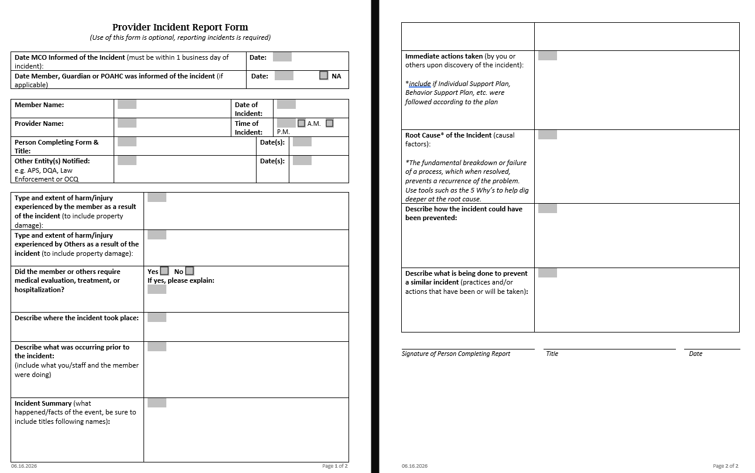
A Provider Incident Report Form is available for providers to utilize when reporting member incidents. The information included on the form assists in providing iCare/Inclusa staff with the necessary information and helps eliminate the need for multiple follow-up conversations.
The use of the form is voluntary. It can be found on the Inclusa.org website under the Provider-Resources tab.

Slide 11


Providers are required to inform iCare/Inclusa of all member changes in condition to include a member’s death.
Providers also need to inform iCare/Inclusa when a member is admitted to a State IMD and/or ITP.​
  IMD = Institute for Mental Disease & ITP = Intensive Treatment Program.
The provider will inform iCare/Inclusa when notifying their regulatory authority of incidents to include the date of the notification(s). A copy of the report(s) may be submitted as a form of notification.
As warranted, reported incidents will be entered into our internal incident management system and reported to DHS in accordance with MCO contract requirements.
Providers may be asked to provide any additional information or details necessary to complete the investigation of reported incidents.
Notes:
Ask karla about updates

Slide 12
Root Cause & Root Cause Analysis
The Provider Incident Report Form asks for the “Root Cause” of the Incident (Causal Factors).
A Root Cause is:
  The fundamental breakdown or failure of process which, when resolved, prevents the recurrence of the problem;
  The factor, when fixed, the problem/issue goes away and does not return.
Root Cause Analysis (RCA) is a method used to address a problem to get to the “root cause.”
There are five steps in RCA:
              Gather Initial Information
              Fill in the Gaps
              Analysis
              Develop Action Plan
              Evaluate Results

Slide 13
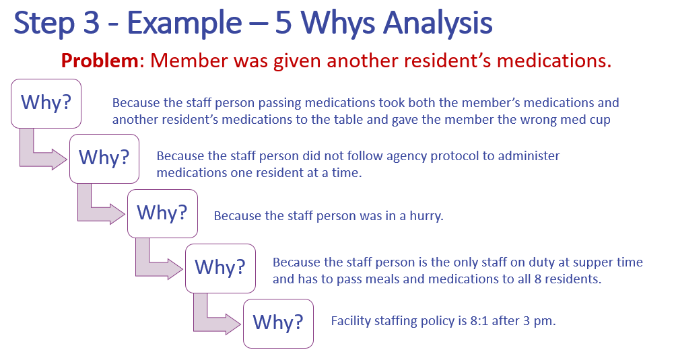
Root Cause Analysis & Prevention Strategies
Step 1 – Gather Initial Information
Step 2 – Fill in the Gaps
Step 3 – Analysis
  Use 5 Whys Analysis to evaluate the problem statement and determine the root cause.
  Ask why until you cannot ask anymore.
Step 4 – Action Plan Development
  Develop interventions based on the root cause.
    Immediate actions to mitigate risk
    Long-term actions
Step 5 – Evaluation of Results
  Questions to consider:
    Were the interventions effective?
    Was the root cause eliminated?
    Was the problem eliminated/reduced?
    Can the change be sustained?
Important: The outcome of the RCA should be included on the Provider Incident Report Form, as well as any prevention strategies you, as a provider, are taking to prevent recurrence of similar incidents in the future.

Slide 14

Thank you for participating in this important training!
Please direct additional questions regarding incident reporting to:
psquality@inclusa.com
Please be certain to sign your attestation page included with your subcontract agreement verifying you have completed this training.

